Slide 1
Customer Segmentation in the Banking Sector using clustering algorithms
UE20CS302 – Machine Intelligence
Mini Project
Project Guide : Prof. Likitha P
Project Team with SRNs :
PES1UG20CS201 - Kaushal Suresh
PES1UG20CS207 - Keshav MN
PES1UG20CS212 - Kiran SS

Slide 2
Problem Statement
With the growth of the market, it has become mandatory for the old businesses to apply marketing strategies to stay in the market due to the increase in competition. The number of consumers is increasing significantly every day and it has become challenging for the businesses to cater to the requirements of every and each customer. Hence, customer segmentation is used which is the process of dividing customers into groups with respect to the common characteristics by which the companies can target each group efficiently.
The aim of this study is to formulate an effective strategy to choose the right target audience in the banking sector to sell different types of Personal loan products, using segmentation methods.

Slide 3
Application and Uses
In the banking sector, customer segmentation can be used for many purposes:
Because segmentation solutions help banks group customers by behavior, they can offer more tailored products and services.
by better understanding customer preferences, marketers can maximize cross and up-selling opportunities and encourage customers to explore related services.
Decide on the right kind of promotional content to send each customer
Select the right marketing channels for the right audience
Identify new and profitable segments and launch innovative products and services

Slide 4
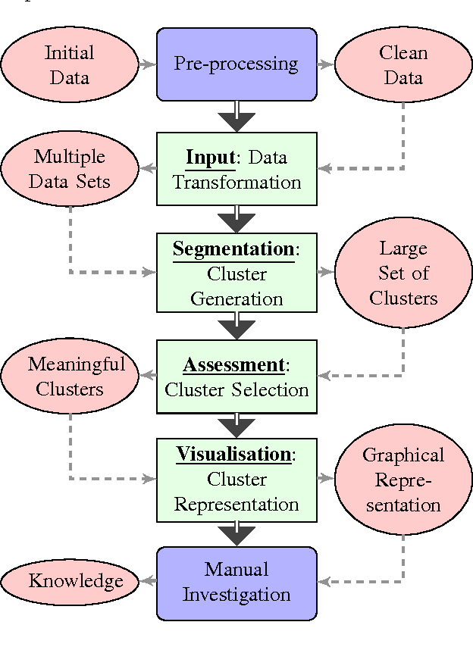
High level Architecture
The data set obtained is passed to the pre-processing stage where duplicates and null rows are dropped. The datatype of columns is converted to the required datatype for pre-processing.
The refined data set is then used to classify the customers into different categories by un-supervised learning through algorithms like K-Means, DBSCAN, HAC, OPTICS and BIRCH.
The resultant clusters can be visualised through scatter plots, and can be compared with the help of their respective Silhouette scores.

Slide 5
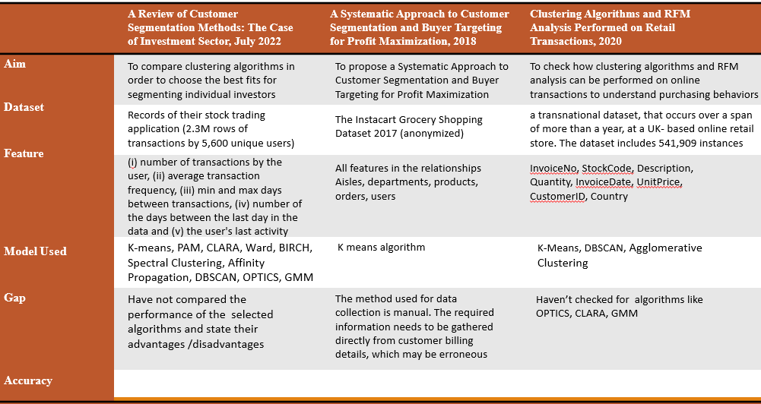
Literature Survey

Slide 6
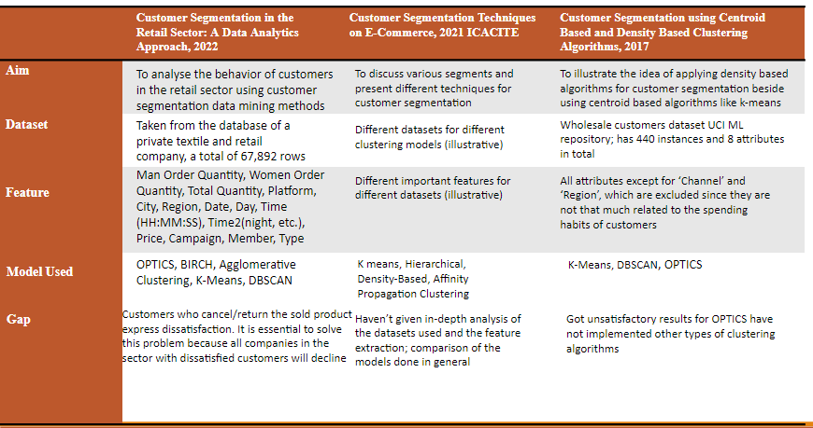
Literature Survey

Slide 7
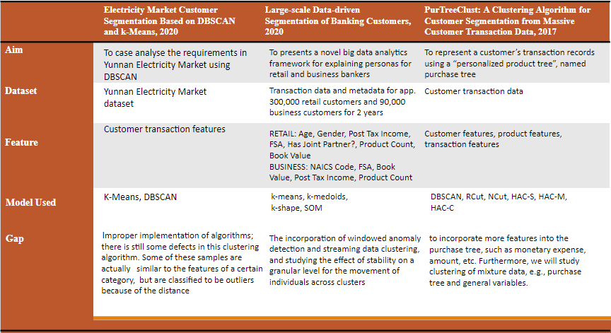
Literature Survey

Slide 8
Proposed Approach
The dataset contains records of 5000 bank customers, trimming the dataset was not required as it was already pre-processed.
Log transformations were applied to the “Income” and “CCAvg” columns
to reduce skewness and increase performance.
We check for Clustering using “Income” and “CCAvg” followed by
Clustering using “Age” and “CCAvg”.
Performed standardisation of data using Standard scaler.
Run different Clustering models to find the best fit (Centroid based,Density based and Hierarchy based).
Visualize each model using scatter plots and looking at means of each cluster.
Check goodness of fit of each model using Silhouette score.

Slide 9
Results and Discussion
Comparison of Silhouette scores:
 | ‘CCAvg’ vs ‘Age’ | ‘CCAvg’ vs ‘Income’
K-Means | 0.376437 | 0.429635
HAC | 0.343680 | 0.419918
DBSCAN | 0.067022 | -0.065037
OPTICS | -0.404996 | -0.395551
BIRCH | 0.334898 | 0.3889856

Slide 10
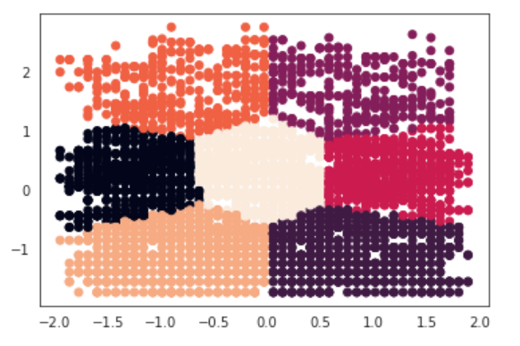
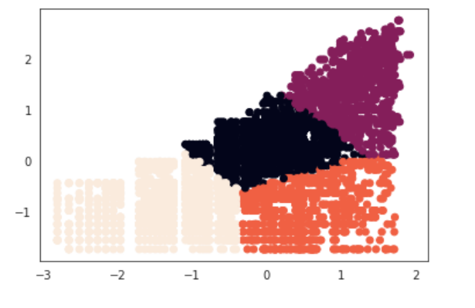
Results and Discussion
‘CCAvg’ vs ‘Age’ (using k-Means)
‘CCAvg’ vs ‘Income’ (using k-Means)

Slide 11
References
https://ieeexplore.ieee.org/document/9862801
https://ieeexplore.ieee.org/document/8494019
https://ieeexplore.ieee.org/document/9298123
https://ieeexplore.ieee.org/document/9903149
https://ieeexplore.ieee.org/abstract/document/9404659
https://ieeexplore.ieee.org/document/8275249
https://ieeexplore.ieee.org/document/9121413
https://ieeexplore.ieee.org/document/9378483
https://ieeexplore.ieee.org/document/8085387

Slide 12
Thank You

